Slide 1

PVA vs CA in the wild: a performance comparison for image transfers

Slide 2
Authors
Bruno Martins
Kunal Shroff
Oksana Ivashkevych

Slide 3
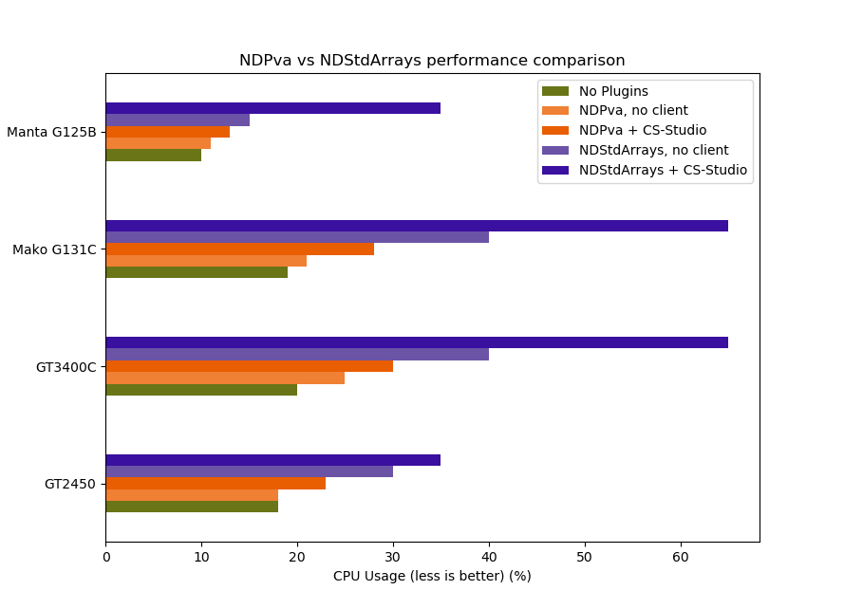
Motivation for using NDPva
The NDPva plugin has been shown to significantly outperform the NDStdArray The use of smart pointers.
The Image MetaData and Image data are packaged together in the NTNDArray Structure ensuring consistency.
https://github.com/areaDetector/ADCore/blob/master/documentation/NDPva_Performance.png

Slide 4
Deployment status of NDPva & CS-Studio
NDPva
Version: ADCore R2-6
Deployed on 3 beamlines
AMX (8 cameras)
FMX (9 cameras)
CHX (2 Eiger detectors)
CS-Studio
Version: 4.3.3

Slide 5
AVT GT3400C
Image size (1692*1352) at 33 Hz
Notes:
deployed v4 at AMX (8 cameras), FMX (9 cameras) and CHX (2 Eiger detectors).
‪ADCore R2-6
‪Camera that we used is a AVT GT3400C
‪ Image size (1692*1352) at 33 Hz
‪Bruno’s – 17ID
‪Oksana’s – 11BM
‪ Prosilica GC1290 M running @ 33 fps h

Slide 6
Prosilica GC1290 M
Image size (1692*1352) at 33 Hz
Notes:
deployed v4 at AMX (8 cameras), FMX (9 cameras) and CHX (2 Eiger detectors).
‪ADCore R2-6
‪Camera that we used is a AVT GT3400C
‪ Image size (1692*1352) at 33 Hz
‪Bruno’s – 17ID
‪Oksana’s – 11BM
‪ Prosilica GC1290 M running @ 33 fps h

Slide 7
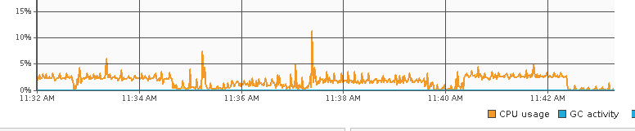
Visualizing images in CS-Studio
Widgets
General widgets - Intensity plot
Specialized widget – Vimage
Formula Function
=ndArray('pva://XF:11BMB-ES{Det:PIL2M}:Pva1:Image') converts a pva NTNDArray into a waveform
=image('pva://XF:11BMB-ES{Det:PIL2M}:Pva1:Image') converts a pva NTNDArray into a Vimage using the metadata (width, height, etc…)
pva Image VImage widget
pva Image Intensity plot widget
V3 Image Intensity plot widget

Slide 8
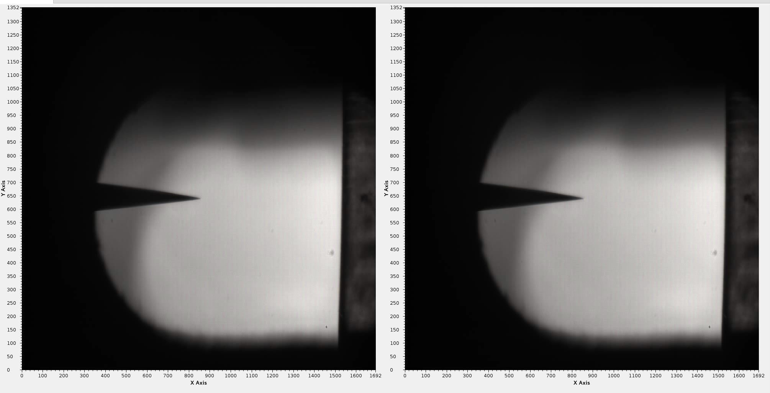
Comparing v4 vs v3

Slide 9
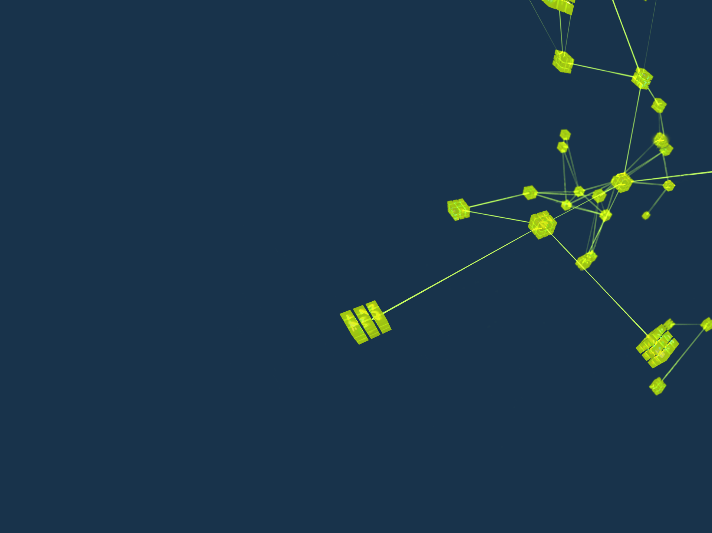
Questions

